Slide 1

職場故事
技術的淬鍊
(Animaze)
Notes:
Air Conditioner, Fan, Cold. Free Stock Video - Pixabay

Slide 2
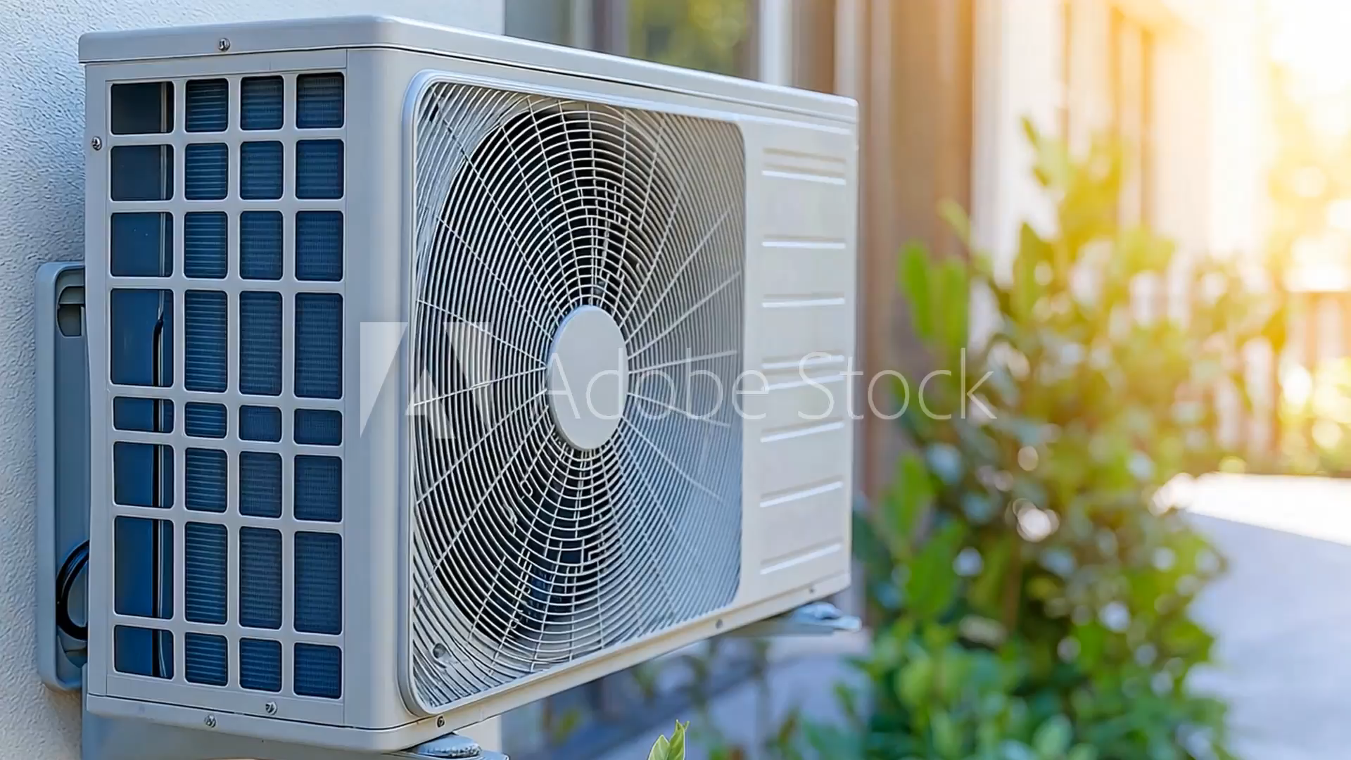
1. 目標
Notes:
https://v.ftcdn.net/09/47/08/70/240_F_947087063_8bgOrWHYyQjrmGyBCqgCu4o5QXfO1kAm_ST.mp4

Slide 3
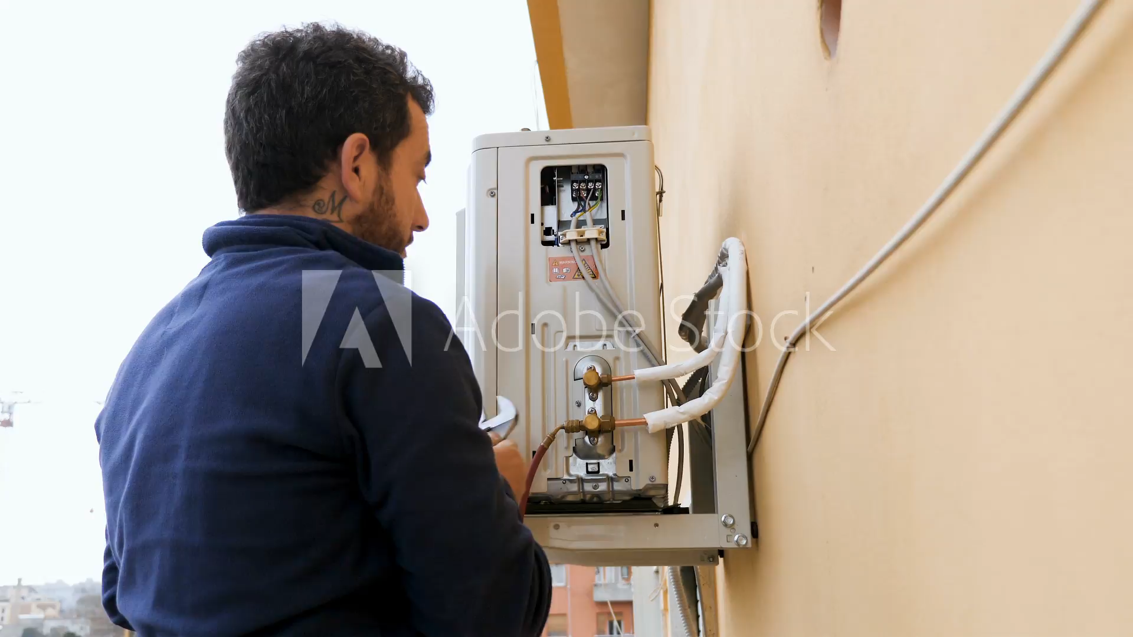
2. 阻礙
Notes:
https://v.ftcdn.net/01/96/50/47/240_F_196504766_gaZk0QevrGXYWodEkf9JUq7DG5sj0xGW_ST.mp4

Slide 4
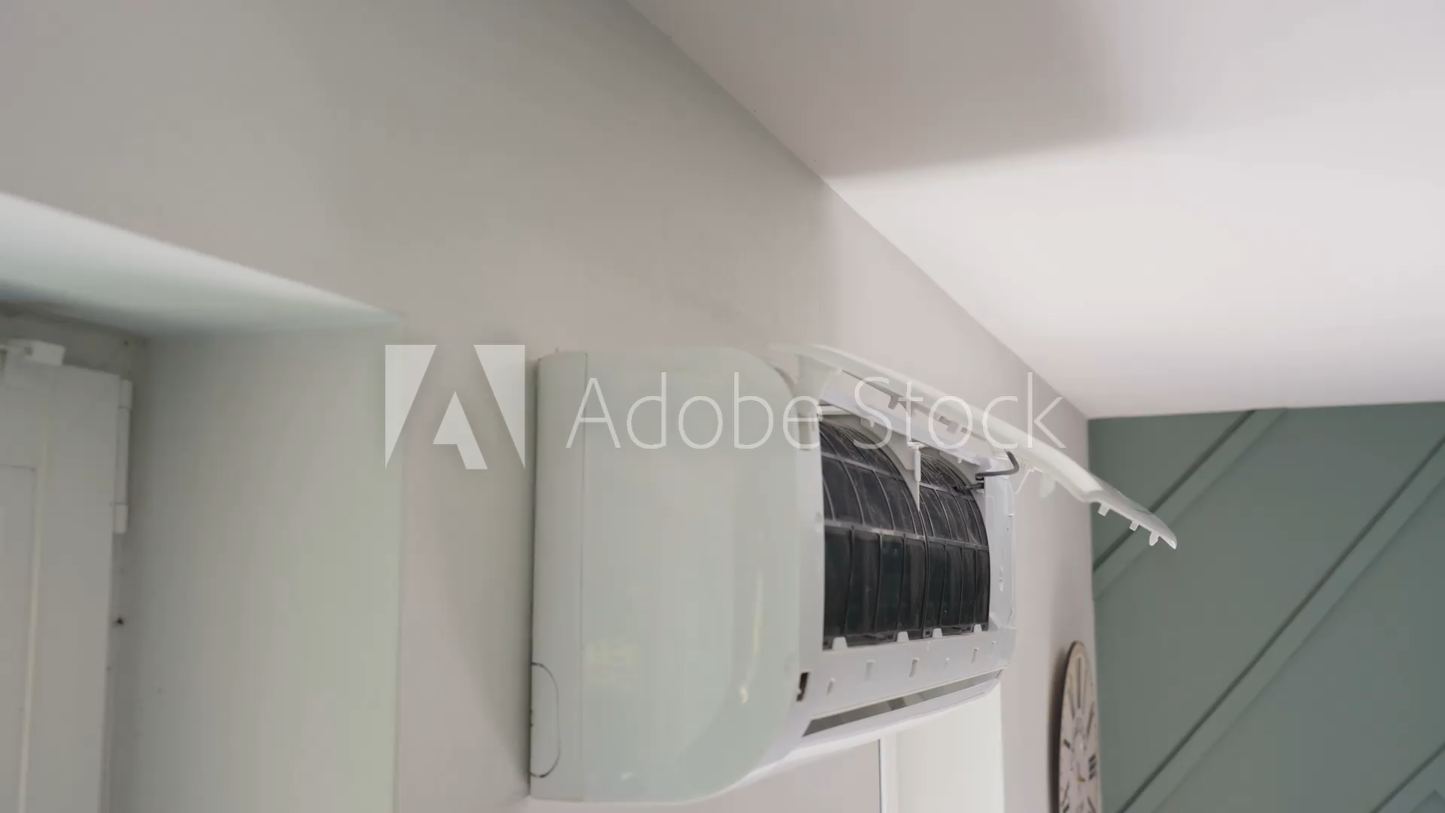
3. 努力
Notes:
https://v.ftcdn.net/08/53/66/79/240_F_853667988_Ir82K48Gac9otIpxBn6mR2rMDEQKhNk8_ST.mp4

Slide 5
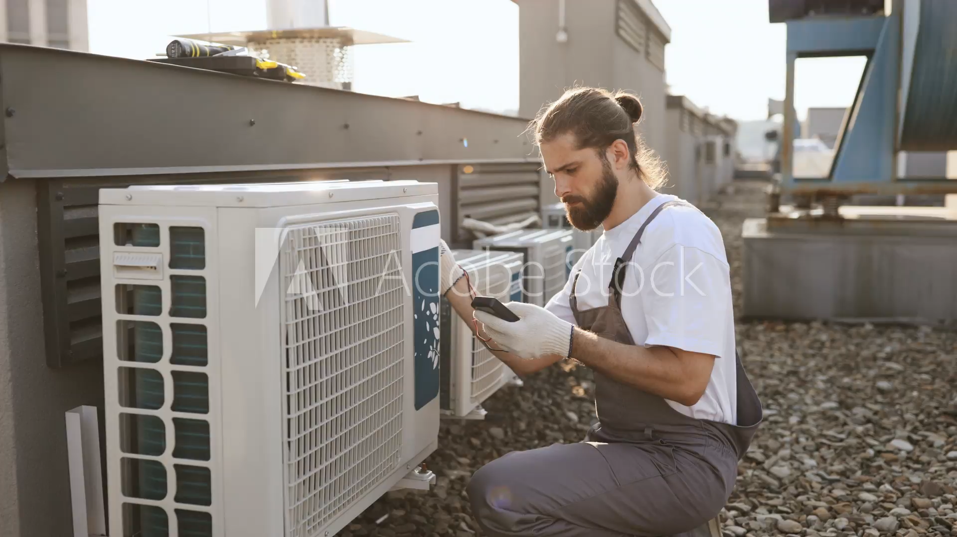
4. 結果
Notes:
https://v.ftcdn.net/06/91/59/06/240_F_691590611_RTMNIaXTFesMDdlVebNcrcY2zVwHuCKG_ST.mp4

Slide 6
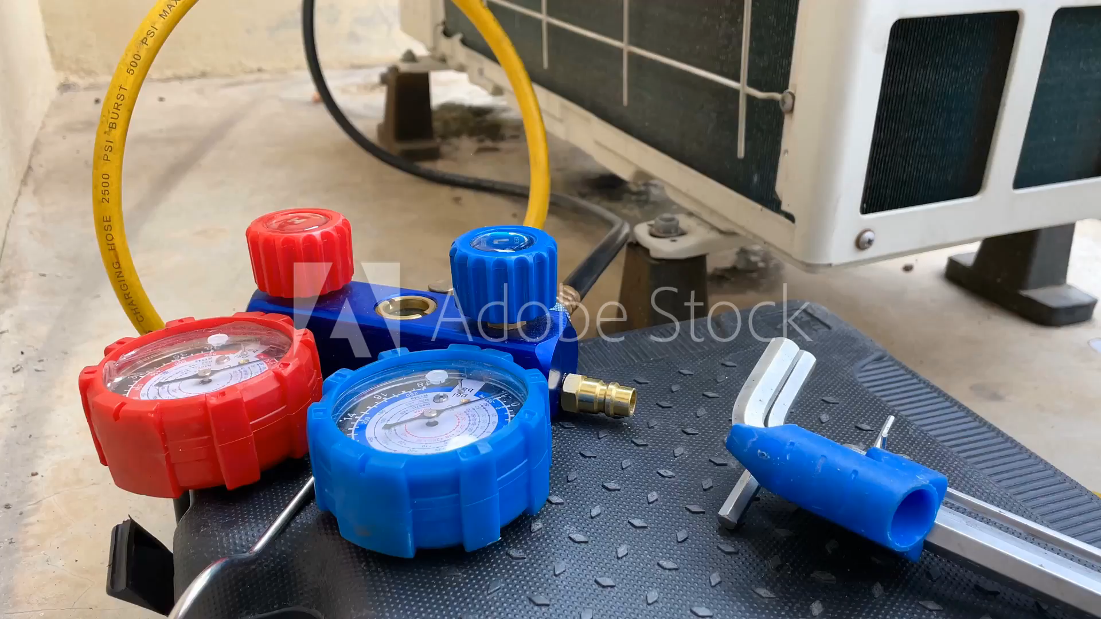
5. 意外
Notes:
https://v.ftcdn.net/08/12/53/77/240_F_812537788_8UUzOoED8JaxVtEj4IXStBqnuV7zrIiF_ST.mp4

Slide 7

6. 轉彎
Notes:
https://v.ftcdn.net/04/11/53/14/240_F_411531441_UC8dW6K1t2HDTzltynOQyBZvgJFK4Z3O_ST.mp4

Slide 8
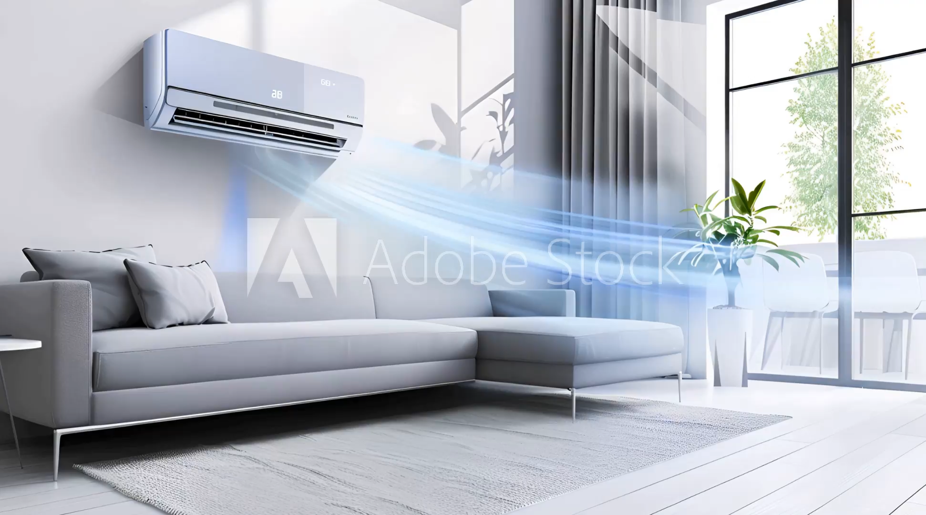
7. 結局
Notes:
https://v.ftcdn.net/07/93/02/24/240_F_793022444_HraQDFgZRZAUYeR03aszWEzAf6LJOKxO_ST.mp4

